Slide 1

System Administration Final Project
Group 7
Aldo Barrera
Devani Almanza
Kathy Tram
Tommy Phang

Slide 2

Our Company
Our mission is to bring community and belonging to everyone in the world!
Our purpose is to create a site allowing for the free flow of information at no charge to the people.
Notes:
https://www.redditinc.com/blog/sharing-our-company-values

Slide 3

Security Measures
MFA - Multi-factor Authentication
Updating drivers, OS, & firewalls
Limiting access control
Backing up data
Hard drive encryption
IDS & IPS - Intrusion Detection System & Intrusion Prevention System
Developing a Security Playbook
NetFlow - Network monitor service
Notes:
MFA uses a combination of different methods of authentication in order to more securely verify that someone is who they say they are– authentication can be based on what you have, what you know, and who you are.
Updating software to the latest version or patch level can help limit the risk of zero-day exploits because the vulnerability that the attacker is exploiting may have been fixed in the new version or patch.
Limiting access control to only people who directly need access to the data will help guard against either intentional or unintentional misuse of company data.
Backing up data will help us in the event of a major event impacting the availability of data, such as a ransomware attack. Having a backup will allow us to have a restore point just in case.
Hard drive encryption will ensure confidentiality in the event that if hardwares are stolen or accessed by an unauthorized party, they will not have access unless they have the specific key needed.
An IDS system will allow us to identify signs of intrusion or suspicious activity and we will use an IPS system to take immediate action against cyber threats such as blocking an IP address from a malicious party.
For our security playbook, we will keep a history of potential threats and their associated risks, as well as the steps that should be taken to mitigate these risks.
NetFlow is a network protocol designed by Cisco that collects information on network traffic, and can be used to identify network usage patterns, troubleshoot network performance issues, and detect security threats.

Slide 4
Permission Settings
Department | Job Duty | Permissions
Moderation | Moderates posts for unwanted content | Access to databases with history on bots, spam, user’s posts
Privacy | Manage and monitor compliance with privacy laws and entity’s privacy policy | Update logs, all the data collected, access to company’s privacy policies, procedures, and documentation
Development | Designs and develops Reddit platform, conceptualizes new updates | Access to databases with history on bots, spam, posts, sole access to source code, project plans, specifications, user requirements, company’s infrastructure
Marketing | Handles third party advertisements to display on site | Site analytics for performance and personalization, access to relevant marketing materials such as social media accounts and email lists

Slide 5
How we Implemented Permissions

Slide 6
Specific Roles Added
Assigned administrator privileges to Development team
Assigned read only to moderator team
Assigned security privileges to privacy policy team.
Assigned data scientist (data analytics) permissions to marketing team.

Slide 7
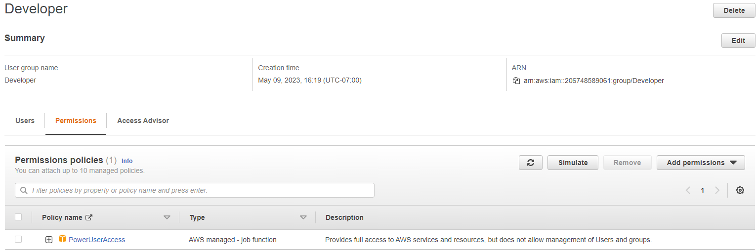
Administrator Access to Developer Team
Notes:
We only administrator access to the development team since they are the only ones who should be able to access it in case something goes wrong. We don’t want other groups having access to administrator privileges since we are going on a need-only basis.

Slide 8
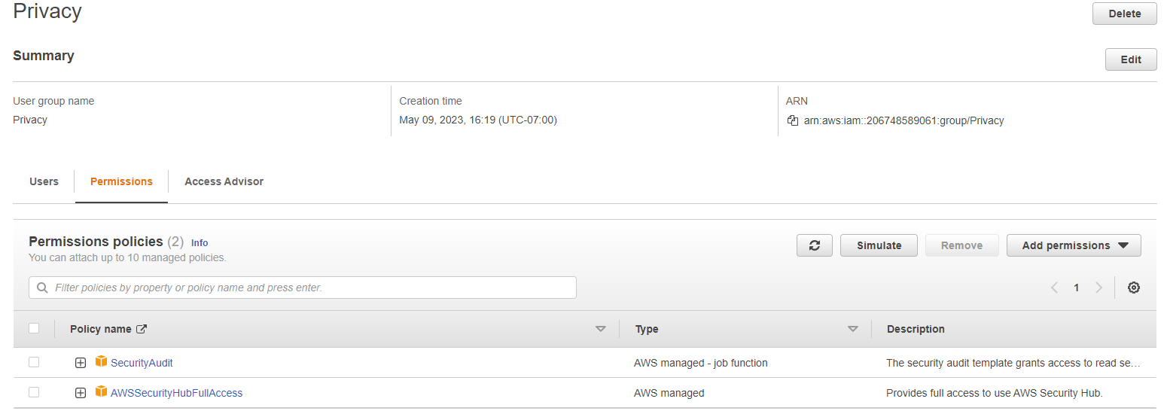
Permissions given to Privacy Team
Notes:
We gave security privileges to the Privacy Team because they are responsible for securing user data, and should be able to update security settings as they see fit.

Slide 9
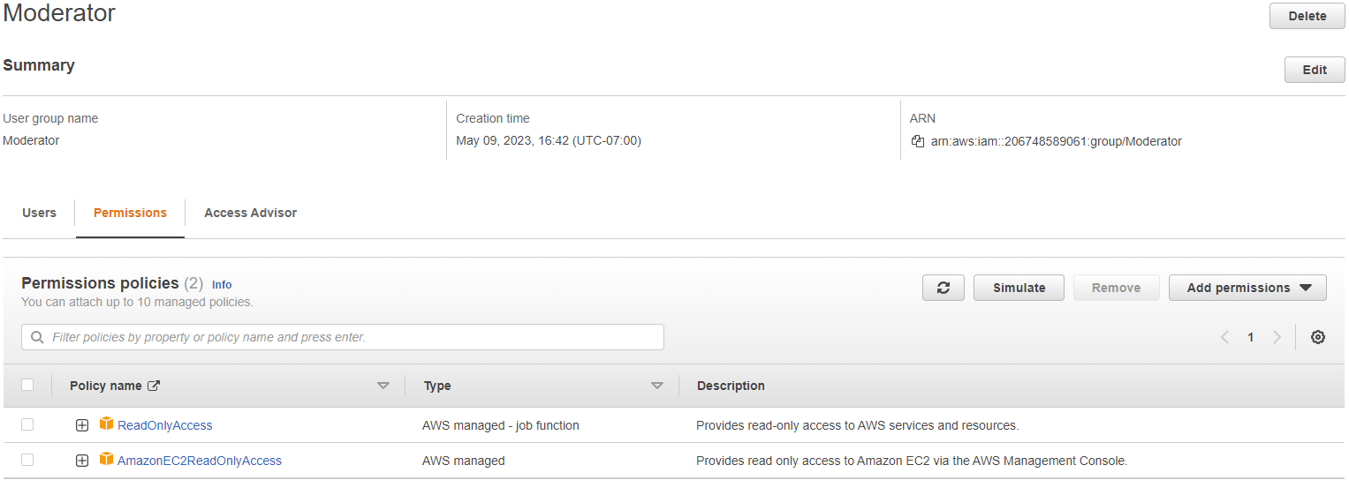
Permissions given to Moderators
Notes:
We gave the Read only access to the Moderators because they should only be able to read the posts and posts history of users, without being able to access their sensitive data.

Slide 10
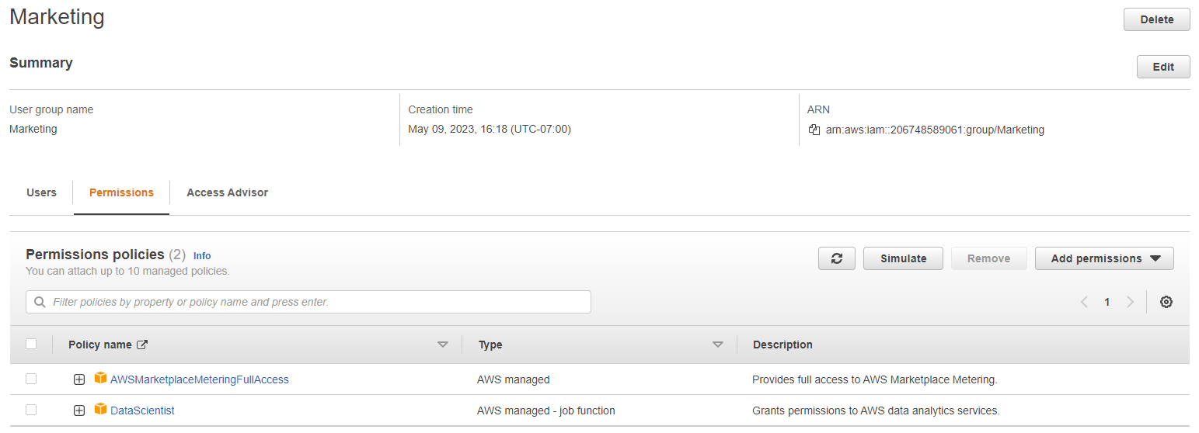
Permissions given to Marketing Team
Notes:
We gave data analytics permissions to the marketing team so that they could take a look at this data collected from users in order to make informed marketing decisions.
AWS Marketplace metering allows the Marketing team to report the usage of their software products, which can also help to achieve their goals.

Slide 11
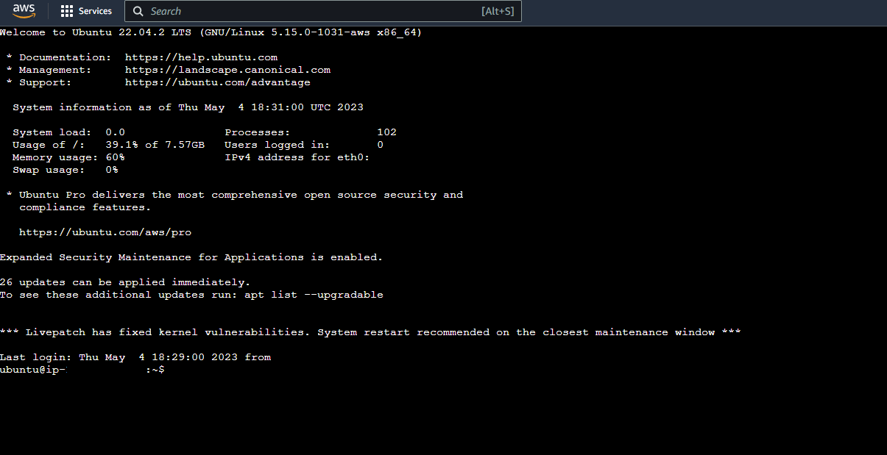
Virtualizing Ubuntu on AWS

Slide 12
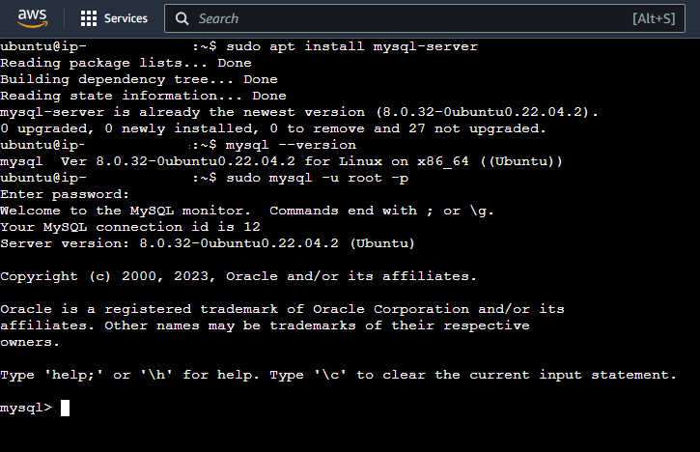
Running SQL on Ubuntu
Installing and running sql:
Sudo apt install mysql-server
Sudo mysql

Slide 13
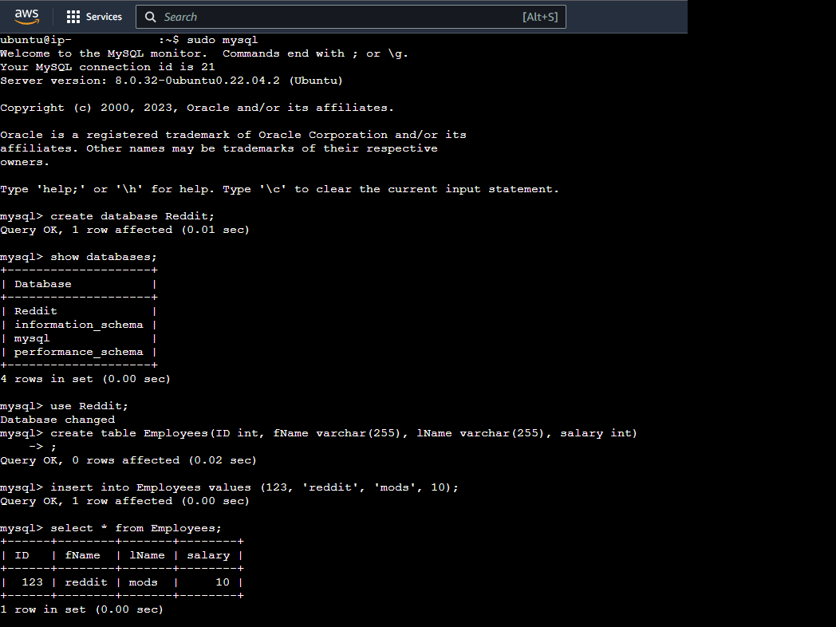
Storing Data on SQL

Slide 14
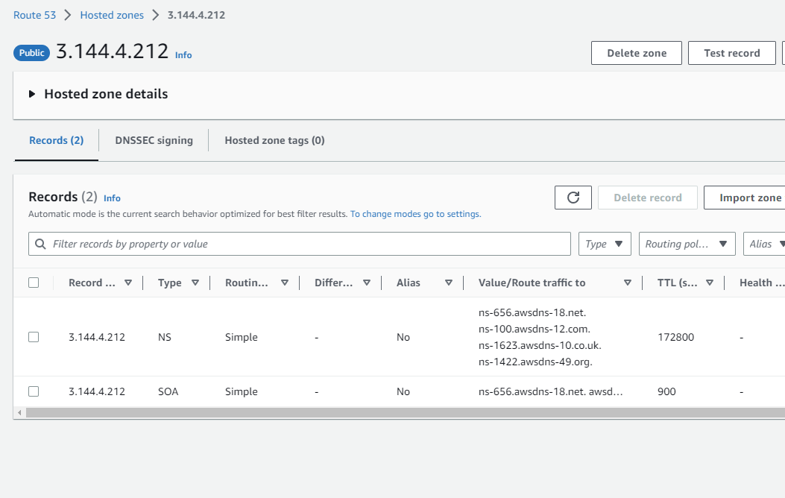
Troubleshooting
Notes:
The wordpress site would not open when we opened the link, so we tried different troubleshooting methods. One of these including attempting to configure the DNS settings of the domain name registrar to point to the Public DNS or Elastic IP address of the EC2 instance but was unsuccessful.

Slide 15
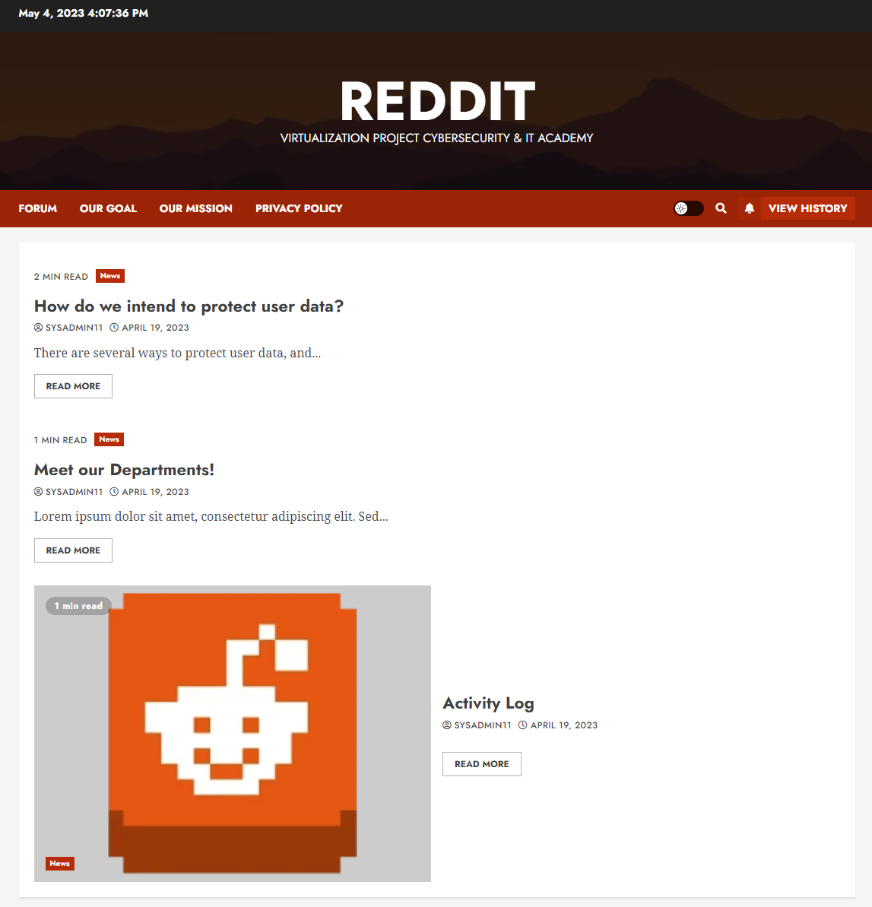
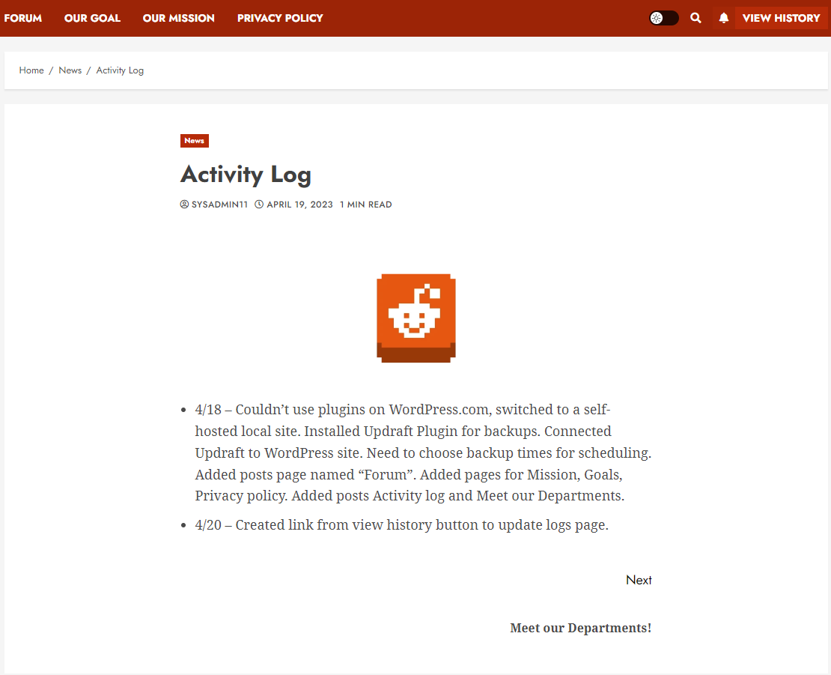
WordPress Site & Update Log

Slide 16
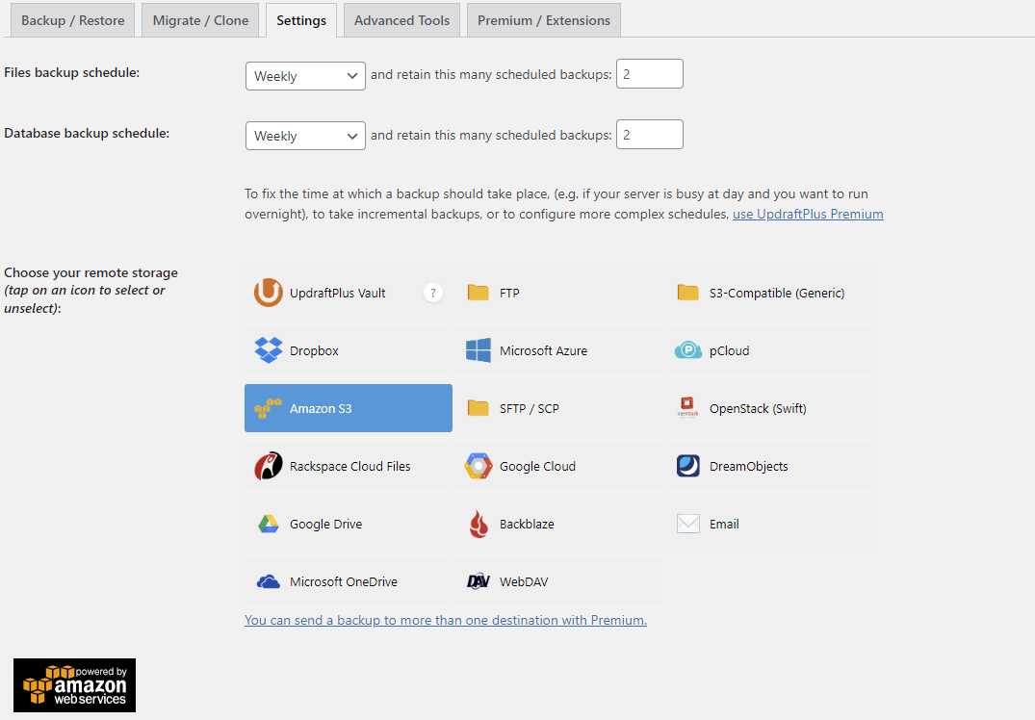

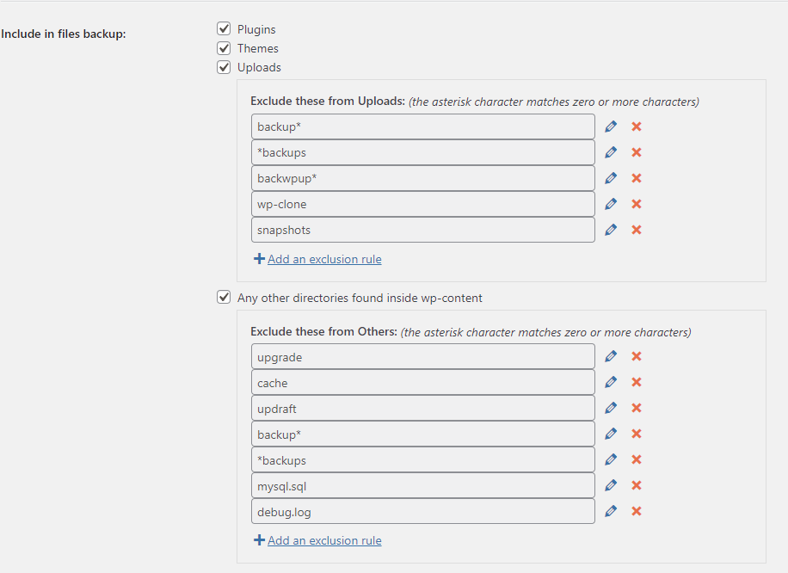
WordPress Scheduled Backups
Used UpdraftPlus plugin to backup to AWS
Obtained the access & secret key to be able to connect
Since we are a small company, we chose to only have weekly backups with 2 backups retained.

Slide 17
Thanks for your time!

